Slide 1
Investigating the Impact of Multicomponent Interactions on Solute Transport via High-Throughput Experiments
Laurianne Estrada, Jonathan A. Ouimet, Keshav K. Rangan, Shammah Lilonfe, Molly Dougher, Zhicheng Lu, Alexander Dowling, William Phillip
2.11.26

Slide 2
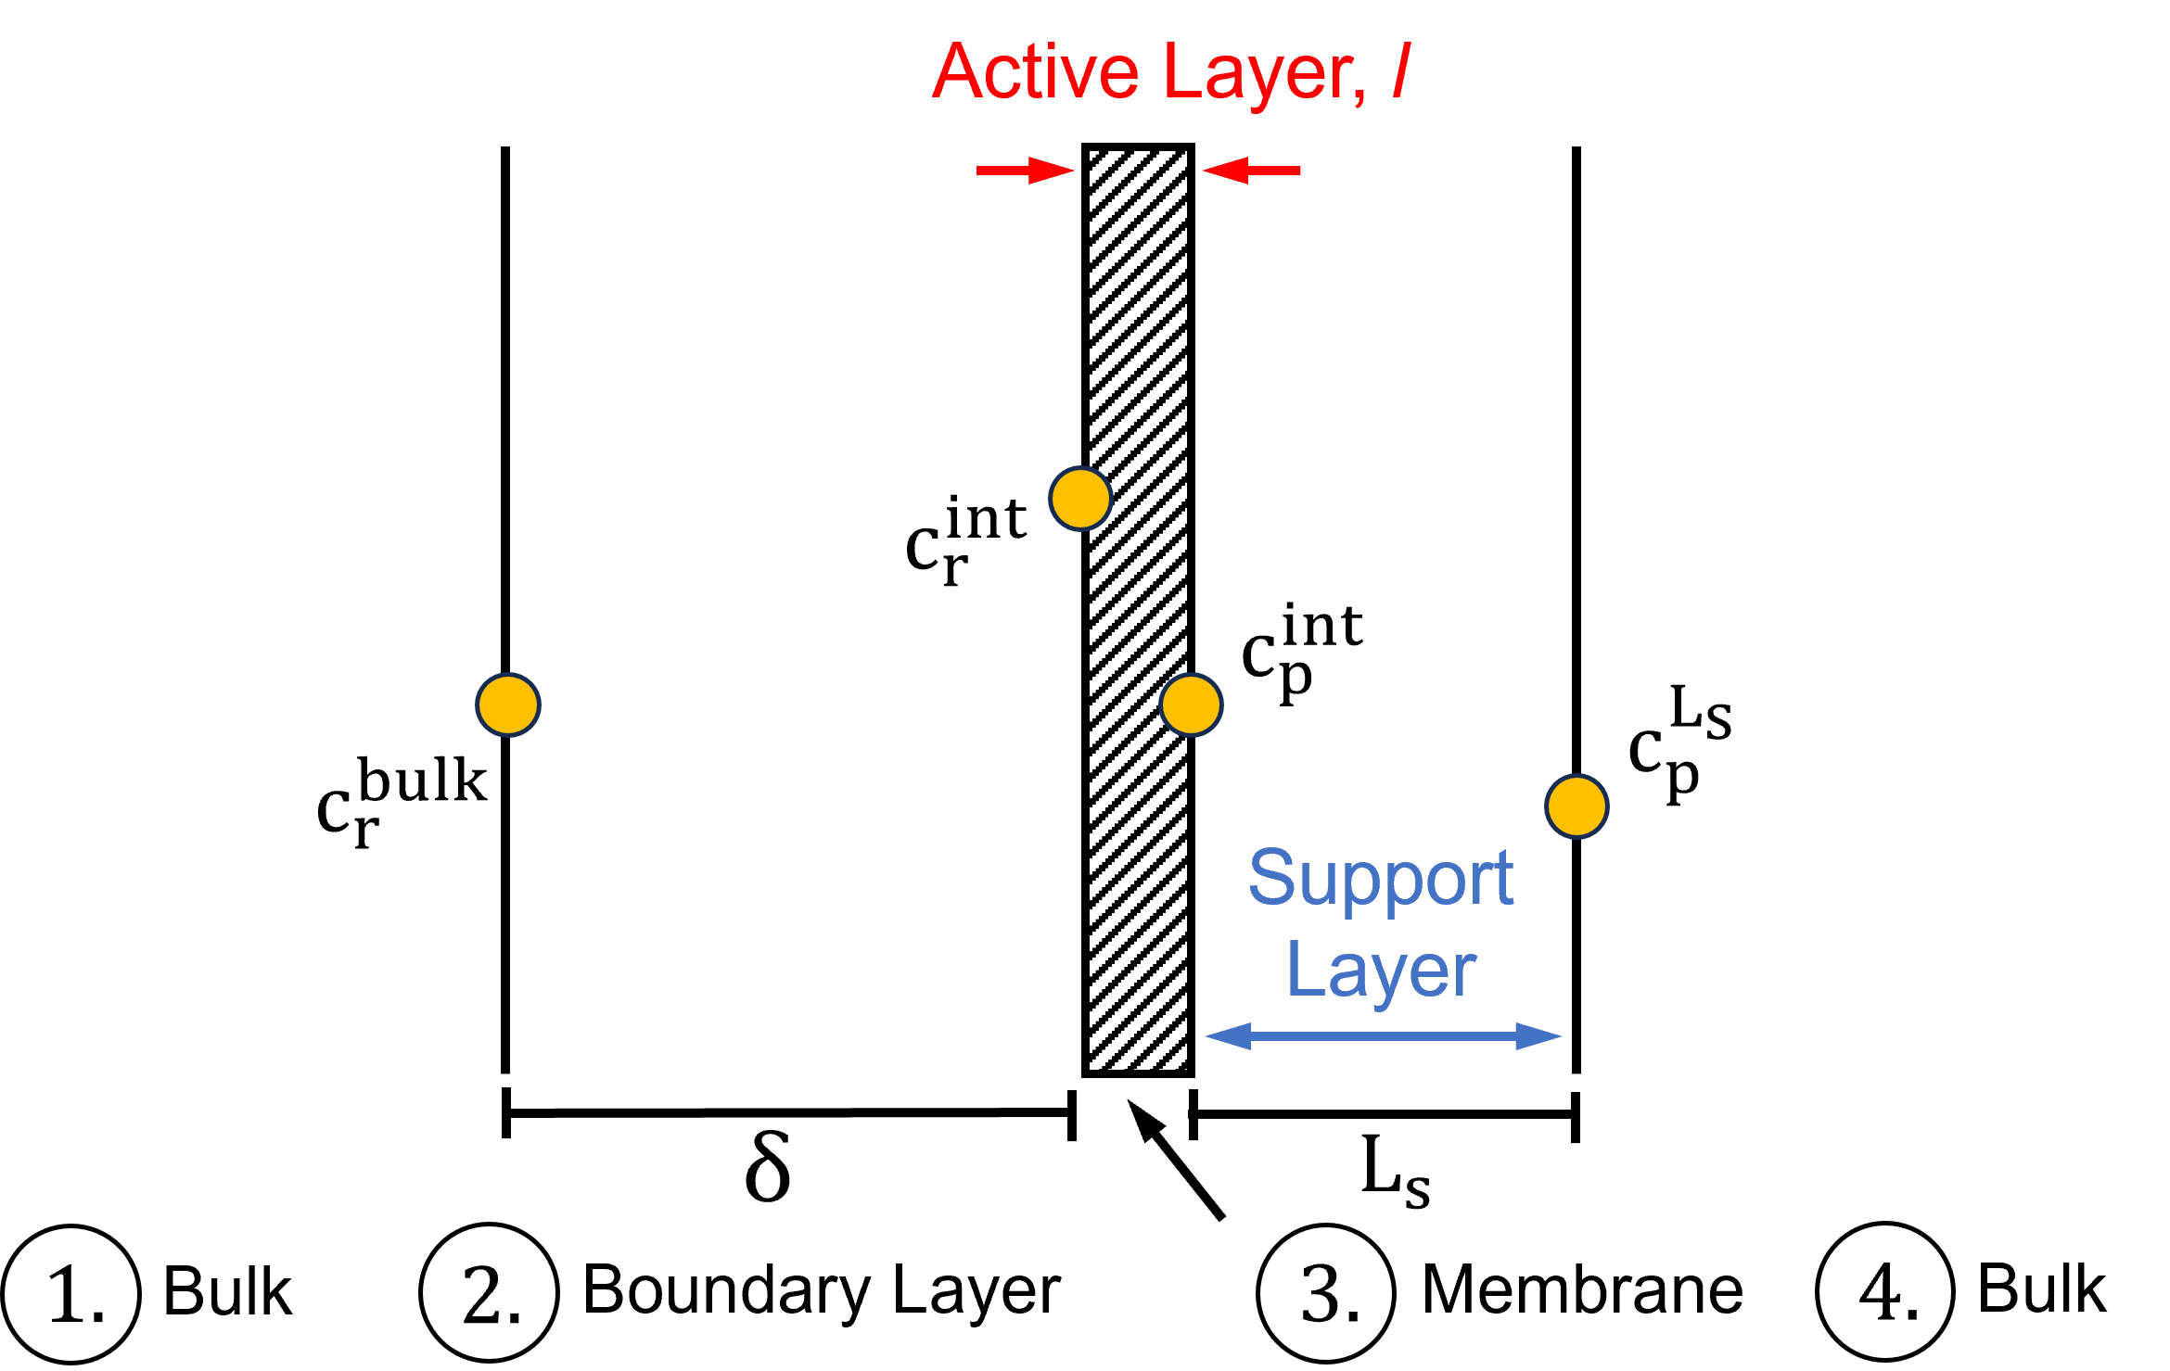
Figure S1 – Membrane Transport Schematic

Slide 3





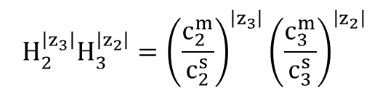
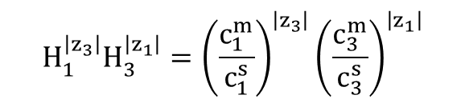


Transport and Thermodynamic Equations
two cations, one anion
Bulk
$$j_{1}^{s}=c_{1}^{s}J_{w}+∇c_{1}^{s}\left(D_{11}\right)+∇c_{2}^{s}\left(D_{12}\right)$$
$$j_{2}^{s}=c_{2}^{s}J_{w}+∇c_{1}^{s}\left(D_{21}\right)+∇c_{2}^{s}\left(D_{22}\right)$$
$$j_{3}^{s}=c_{3}^{s}J_{w}+D_{31}^{s}∇c_{1}^{s}+D_{32}^{s}∇c_{2}^{s}$$
Boundary Layer
$$J_{w}c_{p,1}^{s}=c_{1}^{s}J_{w}+∇c_{1}^{s}\left(D_{11}^{s}\right)+∇c_{2}^{s}\left(D_{12}^{s}\right)$$
$$J_{w}c_{p,2}^{s}=c_{2}^{s}J_{w}+∇c_{1}^{s}\left(D_{21}^{s}\right)+∇c_{2}^{s}\left(D_{22}^{s}\right)$$
$$J_{w}c_{p,3}^{s}=c_{3}^{s}J_{w}+∇c_{1}^{s}\left(D_{31}^{s}\right)+∇c_{2}^{s}\left(D_{32}^{s}\right)$$
Membrane: $χ$ is found in each term
$$j_{1}^{m}=c_{1}^{m}J_{w}+∇c_{1}^{m}\left(D_{11}\right)+∇c_{2}^{m}\left(D_{12}\right)$$
$$j_{2}^{m}=c_{2}^{m}J_{w}+∇c_{1}^{m}\left(D_{21}\right)+∇c_{2}^{m}\left(D_{22}\right)$$
$$j_{3}^{m}=c_{3}^{m}J_{w}+D_{31}^{m}∇c_{1}^{m}+D_{32}^{m}∇c_{2}^{m}$$
$$H_{1}^{\left|z_{3}\right|}H_{3}^{\left|z_{1}\right|}={\left(\frac{c_{1}^{m}}{c_{1}^{s}}\right)}^{\left|z_{3}\right|}{\left(\frac{c_{3}^{m}}{c_{3}^{s}}\right)}^{\left|z_{1}\right|}$$
$$H_{2}^{\left|z_{3}\right|}H_{3}^{\left|z_{2}\right|}={\left(\frac{c_{2}^{m}}{c_{2}^{s}}\right)}^{\left|z_{3}\right|}{\left(\frac{c_{3}^{m}}{c_{3}^{s}}\right)}^{\left|z_{2}\right|}$$

Slide 4
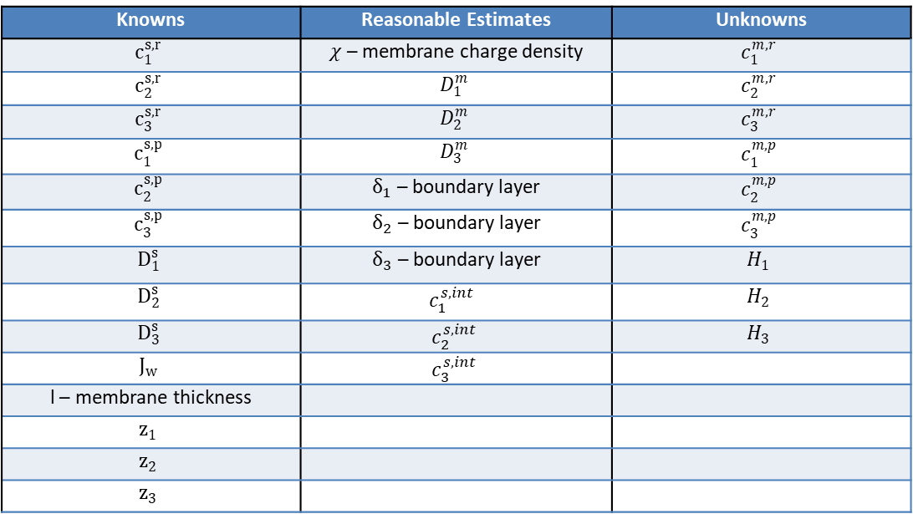
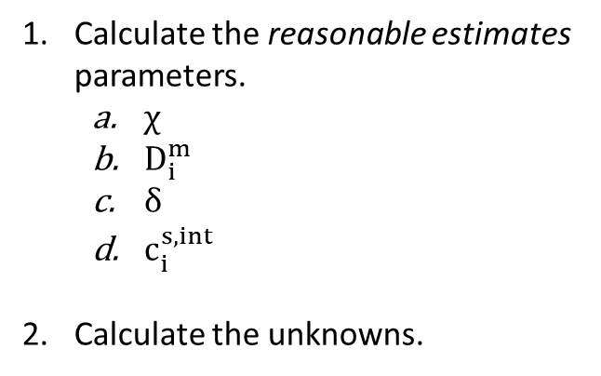
Back-of-the-Envelope Calculations
Knowns | Reasonable Estimates | Unknowns
$$c_{1}^{s,r}$$ | $χ$ – membrane charge density | $$c_{1}^{m,r}$$
$$c_{2}^{s,r}$$ | $$D_{1}^{m}$$ | $$c_{2}^{m,r}$$
$$c_{3}^{s,r}$$ | $$D_{2}^{m}$$ | $$c_{3}^{m,r}$$
$$c_{1}^{s,p}$$ | $$D_{3}^{m}$$ | $$c_{1}^{m,p}$$
$$c_{2}^{s,p}$$ | $δ_{1}$ – boundary layer | $$c_{2}^{m,p}$$
$$c_{3}^{s,p}$$ | $δ_{2}$ – boundary layer | $$c_{3}^{m,p}$$
$$D_{1}^{s}$$ | $δ_{3}$ – boundary layer | $$H_{1}$$
$$D_{2}^{s}$$ | $$c_{1}^{s,int}$$ | $$H_{2}$$
$$D_{3}^{s}$$ | $$c_{2}^{s,int}$$ | $$H_{3}$$
$$J_{w}$$ | $$c_{3}^{s,int}$$
l – membrane thickness
$$z_{1}$$
$$z_{2}$$
$$z_{3}$$
Calculate the reasonable estimates parameters.
$χ$
$D_{i}^{m}$
$δ$
$c_{i}^{s,int}$
Calculate the unknowns.

Slide 5
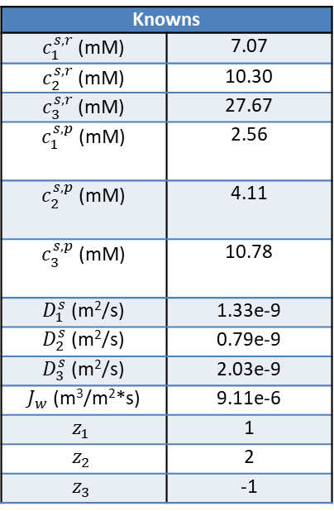
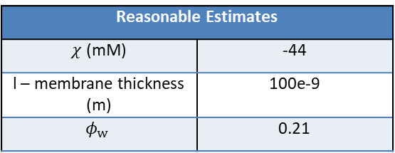
Back-of-the-Envelope Calculations
Experiment: NF270_MC2_05.08.24_E1
Salts: NaCl, CaCl₂
For vial 1:
Knowns
$c_{1}^{s,r}$ (mM) | 7.07
$c_{2}^{s,r}$ (mM) | 10.30
$c_{3}^{s,r}$ (mM) | 27.67
$c_{1}^{s,p}$ (mM) | 2.56
$c_{2}^{s,p}$ (mM) | 4.11
$c_{3}^{s,p}$ (mM) | 10.78
$D_{1}^{s}$ (m²/s) | 1.33e-9
$D_{2}^{s}$ (m²/s) | 0.79e-9
$D_{3}^{s}$ (m²/s) | 2.03e-9
$J_{w}$ (m³/m²*s) | 9.11e-6
$$z_{1}$$ | 1
$$z_{2}$$ | 2
$$z_{3}$$ | -1
Obtain known parameters from experimental data
1. Calculate the reasonable estimate parameters from the literature.
Reasonable Estimates
$χ$ (mM) | -44
l – membrane thickness (m) | 100e-9
$$φ_{w}$$ | 0.21
Notes:
NF270 DATA2: concentration of KCl in chi calculation was set to 10mM but was supposed to be 1mM. That is why the paper says -140mM but here it says -44mM.

Slide 6
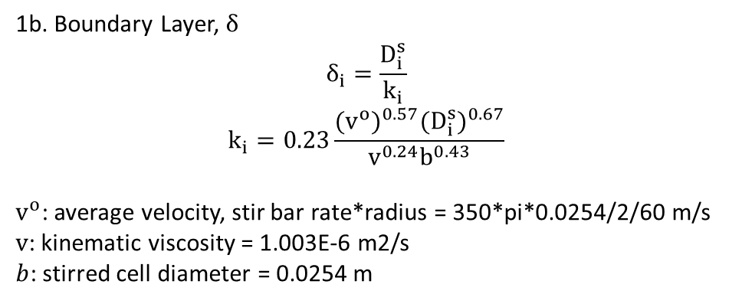
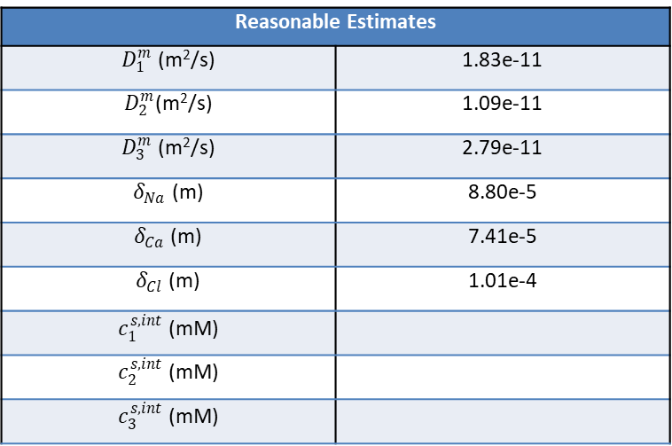
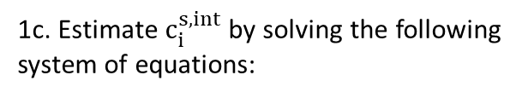
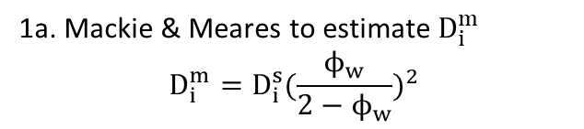
Back-of-the-Envelope Calculations
Experiment: NF270_MC2_05.08.24_E1
Salts: NaCl, CaCl₂
Reasonable Estimates
$D_{1}^{m}$ (m²/s) | 1.83e-11
$D_{2}^{m}$(m²/s) | 1.09e-11
$D_{3}^{m}$ (m²/s) | 2.79e-11
$δ_{Na}$ (m) | 8.80e-5
$δ_{Ca}$ (m) | 7.41e-5
$δ_{Cl}$ (m) | 1.01e-4
$c_{1}^{s,int}$ (mM)
$c_{2}^{s,int}$ (mM)
$c_{3}^{s,int}$ (mM)
1. Calculate the reasonable estimate parameters.
1a. Mackie & Meares to estimate $D_{i}^{m}$
$$D_{i}^{m}=D_{i}^{s}{(\frac{ϕ_{w}}{2−ϕ_{w}})}^{2}$$
1b. Boundary Layer, $δ$
$$δ_{i}=\frac{D_{i}^{s}}{k_{i}}$$
$$k_{i}=0.23\frac{{(v^{o})}^{0.57}{(D_{i}^{s})}^{0.67}}{v^{0.24}b^{0.43}}$$
$v^{o}$: average velocity, stir bar rate*radius = 350*pi*0.0254/2/60 m/s
$v$: kinematic viscosity = 1.003E-6 m2/s
$b$: stirred cell diameter = 0.0254 m
1c. Estimate $c_{i}^{s,int}$ by solving the following system of equations:
$$J_{w}c_{p,1}^{s}=c_{1}^{s}J_{w}+∇c_{1}^{s}\left(D_{11}^{s}\right)+∇c_{2}^{s}\left(D_{12}^{s}\right)$$
$$J_{w}c_{p,2}^{s}=c_{2}^{s}J_{w}+∇c_{1}^{s}\left(D_{21}^{s}\right)+∇c_{2}^{s}\left(D_{22}^{s}\right)$$
Notes:
Mackie & Meares model: 1) polymer chains are hard obstacles and the ion must diffuse around these through the water volume pockets (tortuosity). 2) no specific interactions. 3) uniform swelling. 4) small, simple ions (Na+, Cl-). 5) polymer chains arranged in a cubic lattice.
Stuck at solving the system of equations for c,int. Will be working through this as next steps, but generally this is the current workflow.

Slide 7
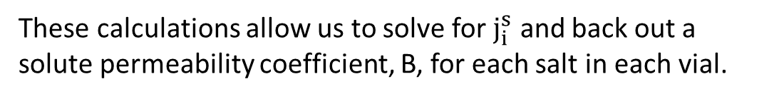
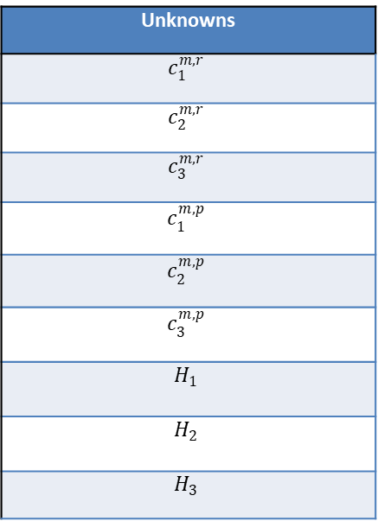
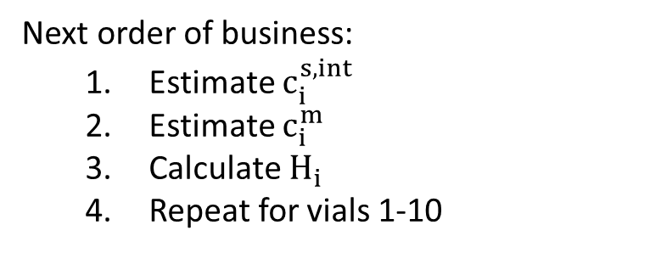

Next Steps & Upcoming Work
2. Calculate the unknown variables.
Unknowns
$$c_{1}^{m,r}$$
$$c_{2}^{m,r}$$
$$c_{3}^{m,r}$$
$$c_{1}^{m,p}$$
$$c_{2}^{m,p}$$
$$c_{3}^{m,p}$$
$$H_{1}$$
$$H_{2}$$
$$H_{3}$$
2a. Estimate $c_{i}^{m}$ by solving the following system of equations:
$$J_{w}c_{p,1}^{s}=c_{1}^{s}J_{w}+∇c_{1}^{s}\left(D_{11}^{s}\right)+∇c_{2}^{s}\left(D_{12}^{s}\right)$$
$$j_{1}^{m}=c_{1}^{m}J_{w}+∇c_{1}^{m}\left(D_{11}\right)+∇c_{2}^{m}\left(D_{12}\right)$$
2b. Calculate the partition coefficient, $H_{i}$.
2c. Calculate the solute permeability coefficient, $B_{i}$.
$$B_{i}=J_{w}\frac{1−R_{i}}{R_{i}}$$
Next order of business:
Estimate $c_{i}^{s,int}$
Estimate $c_{i}^{m}$
Calculate $H_{i}$
Repeat for vials 1-10
These calculations allow us to solve for $j_{i}^{s}$ and back out a solute permeability coefficient, B, for each salt in each vial.

Slide 8

Full equations
Bulk
$$j_{1}^{s}=c_{1}^{s}J_{w}+∇c_{1}^{s}\left(\frac{{\left|z_{1}\right|}^{2}D_{1}^{s}D_{3}^{s}c_{1}^{s}+\left|z_{1}\right|\left|z_{3}\right|D_{1}^{s}D_{3}^{s}c_{1}^{s}−{\left|z_{2}\right|}^{2}{D_{1}^{s}D}_{2}^{s}c_{2}^{s}+\left|z_{2}\right|\left|z_{3}\right|D_{1}^{s}D_{3}^{s}c_{2}^{s}}{c_{1}^{s}\left({\left|z_{1}\right|}^{2}D_{1}^{s}−\left|z_{1}\right|\left|z_{3}\right|D_{3}^{s}\right)+c_{2}^{s}\left({\left|z_{2}\right|}^{2}D_{2}^{s}−\left|z_{2}\right|\left|z_{3}\right|D_{3}^{s}\right)}\right)+∇c_{2}^{s}\left(\frac{\left|z_{1}\right|\left|z_{2}\right|D_{1}^{s}D_{2}^{s}c_{1}^{s}+\left|z_{1}\right|\left|z_{2}\right|D_{1}^{s}D_{3}^{s}c_{1}^{s}}{c_{1}^{s}\left({\left|z_{1}\right|}^{2}D_{1}^{s}−\left|z_{1}\right|\left|z_{3}\right|D_{3}^{s}\right)+c_{2}^{s}\left({\left|z_{2}\right|}^{2}D_{2}^{s}−\left|z_{2}\right|\left|z_{3}\right|D_{3}^{s}\right)}\right)$$
$$j_{2}^{s}=c_{2}^{s}J_{w}+∇c_{1}^{s}\left(\frac{\left|z_{1}\right|\left|z_{2}\right|D_{1}^{s}D_{2}^{s}c_{2}^{s}+\left|z_{1}\right|\left|z_{2}\right|D_{2}^{s}D_{3}^{s}c_{2}^{s}}{c_{1}^{s}\left({\left|z_{1}\right|}^{2}D_{1}^{s}−\left|z_{1}\right|\left|z_{3}\right|D_{3}^{s}\right)+c_{2}^{s}\left({\left|z_{2}\right|}^{2}D_{2}^{s}−\left|z_{2}\right|\left|z_{3}\right|D_{3}^{s}\right)}\right)+∇c_{2}^{s}\left(\frac{{\left|z_{1}\right|}^{2}D_{1}^{s}D_{2}^{s}c_{1}^{s}+\left|z_{1}\right|\left|z_{3}\right|D_{2}^{s}D_{3}^{s}c_{1}^{s}−{\left|z_{2}\right|}^{2}{D_{2}^{s}D}_{3}^{s}c_{2}^{s}+\left|z_{2}\right|\left|z_{3}\right|D_{2}^{s}D_{3}^{s}c_{2}^{s}}{c_{1}^{s}\left({\left|z_{1}\right|}^{2}D_{1}^{s}−\left|z_{1}\right|\left|z_{3}\right|D_{3}^{s}\right)+c_{2}^{s}\left({\left|z_{2}\right|}^{2}D_{2}^{s}−\left|z_{2}\right|\left|z_{3}\right|D_{3}^{s}\right)}\right)$$
$$j_{3}^{s}=\frac{\left|z_{1}\right|}{\left|z_{3}\right|}j_{1}^{s}+\frac{\left|z_{2}\right|}{\left|z_{3}\right|}j_{2}^{s}$$
Boundary Layer
$$J_{w}c_{p,1}^{s}=c_{1}^{s}J_{w}+∇c_{1}^{s}\left(D_{11}^{s}\right)+∇c_{2}^{s}\left(D_{12}^{s}\right)$$
$$J_{w}c_{p,2}^{s}=c_{2}^{s}J_{w}+∇c_{1}^{s}\left(D_{21}^{s}\right)+∇c_{2}^{s}\left(D_{22}^{s}\right)$$
$$J_{w}c_{p,3}^{s}=c_{3}^{s}J_{w}+∇c_{1}^{s}\left(D_{31}^{s}\right)+∇c_{2}^{s}\left(D_{32}^{s}\right)$$

Slide 9

Full equations
Membrane
$$j_{1}^{m}=c_{1}^{m}J_{w}\left(1−\frac{\left|z_{1}\right|D_{1}^{m}χ}{c_{1}^{m}\left({\left|z_{1}\right|}^{2}D_{1}^{m}+\left|z_{1}\right|\left|z_{3}\right|D_{3}^{m}\right)+c_{2}^{m}\left({\left|z_{2}\right|}^{2}D_{2}^{m}+\left|z_{2}\right|\left|z_{3}\right|D_{3}^{m}\right)−\left|z_{3}\right|D_{3}^{m}χ}\right) +∇c_{1}^{m}\left(\frac{-{\left|z_{1}\right|}^{2}D_{1}^{m}D_{3}^{m}c_{1}^{m}−\left|z_{1}\right|\left|z_{3}\right|{D_{1}^{m}D}_{3}^{m}c_{1}^{m}−{\left|z_{2}\right|}^{2}D_{1}^{m}D_{2}^{m}c_{2}^{m}−\left|z_{2}\right|\left|z_{3}\right|D_{1}^{m}D_{3}^{m}c_{2}^{m}+\left|z_{3}\right|D_{1}^{m}D_{3}^{m}χ}{c_{1}^{m}\left({\left|z_{1}\right|}^{2}D_{1}^{m}+\left|z_{1}\right|\left|z_{3}\right|D_{3}^{m}\right)+c_{2}^{m}\left({\left|z_{2}\right|}^{2}D_{2}^{m}+\left|z_{2}\right|\left|z_{3}\right|D_{3}^{m}\right)−\left|z_{3}\right|D_{3}^{m}χ}\right)+∇c_{2}^{m}\left(\frac{\left|z_{1}\right|\left|z_{2}\right|D_{1}^{m}D_{2}^{m}c_{1}^{m}−\left|z_{1}\right|\left|z_{2}\right|D_{1}^{m}D_{3}^{m}c_{1}^{m}}{c_{1}^{m}\left({\left|z_{1}\right|}^{2}D_{1}^{m}+\left|z_{1}\right|\left|z_{3}\right|D_{3}^{m}\right)+c_{2}^{m}\left({\left|z_{2}\right|}^{2}D_{2}^{m}+\left|z_{2}\right|\left|z_{3}\right|D_{3}^{m}\right)−\left|z_{3}\right|D_{3}^{m}χ}\right)$$
$$j_{2}^{m}=c_{2}^{m}J_{w}\left(1−\frac{\left|z_{2}\right|D_{2}^{m}χ}{c_{1}^{m}\left({\left|z_{1}\right|}^{2}D_{1}^{m}+\left|z_{1}\right|\left|z_{3}\right|D_{3}^{m}\right)+c_{2}^{m}\left({\left|z_{2}\right|}^{2}D_{2}^{m}+\left|z_{2}\right|\left|z_{3}\right|D_{3}^{m}\right)−\left|z_{3}\right|D_{3}^{m}χ}\right)+∇c_{1}^{m}\left(\frac{\left|z_{1}\right|\left|z_{2}\right|D_{1}^{m}D_{2}^{m}c_{2}^{m}−\left|z_{1}\right|\left|z_{2}\right|D_{1}^{m}D_{3}^{m}c_{2}^{m}}{c_{1}^{m}\left({\left|z_{1}\right|}^{2}D_{1}^{m}+\left|z_{1}\right|\left|z_{3}\right|D_{3}^{m}\right)+c_{2}^{m}\left({\left|z_{2}\right|}^{2}D_{2}^{m}+\left|z_{2}\right|\left|z_{3}\right|D_{3}^{m}\right)−z_{3}D_{3}^{m}χ}\right)+∇c_{2}^{m}\left(\frac{{-\left|z_{1}\right|}^{2}D_{1}^{m}D_{2}^{m}c_{1}^{m}−\left|z_{1}\right|\left|z_{3}\right|{D_{2}^{m}D}_{3}^{m}c_{1}^{m}−{\left|z_{2}\right|}^{2}D_{2}^{m}D_{3}^{m}c_{2}^{m}−\left|z_{2}\right|\left|z_{3}\right|D_{2}^{m}D_{3}^{m}c_{2}^{m}+\left|z_{3}\right|D_{2}^{m}D_{3}^{m}χ}{c_{1}^{m}\left({\left|z_{1}\right|}^{2}D_{1}^{m}+\left|z_{1}\right|\left|z_{3}\right|D_{3}^{m}\right)+c_{2}^{m}\left({\left|z_{2}\right|}^{2}D_{2}^{m}+\left|z_{2}\right|\left|z_{3}\right|D_{3}^{m}\right)−z_{3}D_{3}^{m}χ}\right)$$
$$j_{3}^{m}=\frac{\left|z_{1}\right|}{\left|z_{3}\right|}j_{1}^{m}+\frac{\left|z_{2}\right|}{\left|z_{3}\right|}j_{2}^{m}$$

